Slide 1


Metabolomics Applications to Human Health
Leiden University Retreat
May 2023
Patrick Arnott, PhD
Greg Michelotti, PhD
Alessandro Busetti, PhD

Slide 2




20 years of leadership in metabolomics
Unrivalled capabilities
Unique industrial scale technology platform, knowledgebase and AI/bioinformatics capabilities generate high barriers to entry
Leading expertise in biochemistry and its role in health, wellness, nutrition and disease
is the global leader in metabolomics: the next omics revolution
Growing services business
Transitioning into clinical applications
Providing metabolomics solutions that support the research continuum from discovery through clinical trials, to in-market life cycle management
Building a multi-omic disease database for biomarker discovery and clinical test development in rare and common diseases

Slide 3
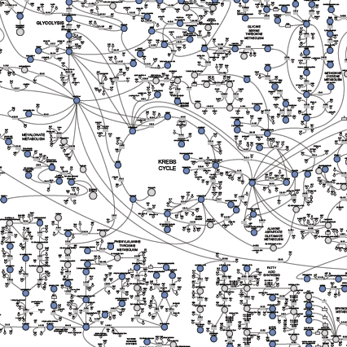
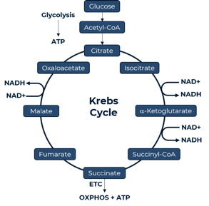
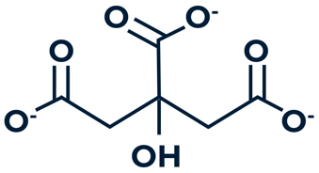
Metabolon has transformed biochemistry into an omics technology and is delivering this on an industrial scale
The ability to perform massively parallel sampling in biology has been transformational to researchers’ ability to perform large-scale and unbiased biological analysis
Any transition from a healthy to disease state requires changes in biochemistry
Metabolites are therefore excellent biomarkers for diagnosis and pathogenesis of large numbers of diseases
citrate
Metabolism is a collection of biochemical reactions that enable life
These reactions are organized into 100’s of highly conserved pathways
Metabolites are the chemical intermediaries and endpoints of these reactions
Metabolomics is the large scale study of these metabolites
Notes:
And I think it is important to reiterate Brian’s point that metabolism is closest to the phenotype. This means that metabolism is at the center of every biological process and that any transition from a healthy to a disease state requires a change in at least one biochemical step, uniquely poising metabolites as powerful markers for diagnostic, prognostic and therapeutic applications

Slide 4

Metabolomics is Closer to the Phenotype and Can Help the Understanding of Other Omics
WHAT COULD BE
FUNCTIONAL EXPRESSION OF WHAT IS
Genomics
Proteomics
Metabolomics
Ilumina, 10x Genomics, PacBio
Seer, SomaLogic, Olink
Metabolon
Genomics is complicated with limited contribution to the majority of diseases.
Proteomics faces similar complexity—single proteins exist in multiple different forms that dictate activity.
Metabolomics is the definitive representation of the phenotype—associations from diseases to metabolites produce direct links to biological mechanisms.
METABOLOMICS CAN HELP THE FUNCTIONAL UNDERSTANDING OF THE GENOME AND PROTEOME

Slide 5
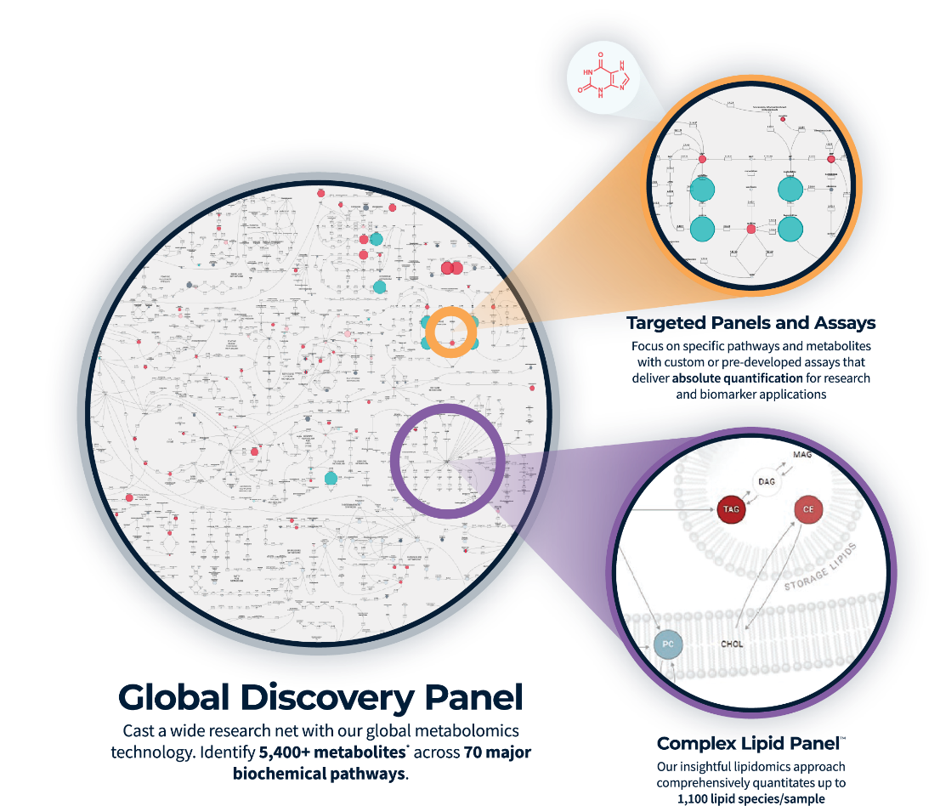
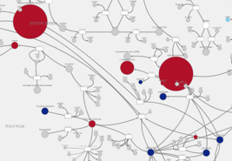
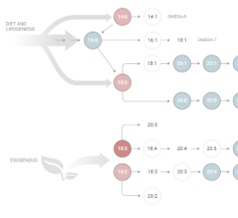
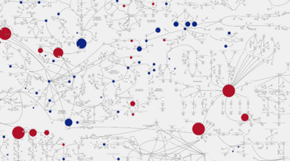
Metabolomics Solutions
FIT FOR PURPOSE TOOLS
DELIVERING HIGH-QUALITY DATA AND INSIGHTS
Complex Lipids Targeted Panel
Notes:
At metabolon we developed three main solutions for metabolomics:
global untargetd metabolomics analysis – it is the most powerful approach for biomarker discovery that we offer. We can profile with a high degree of chemical accuracy over 5000 metabolites allowing us to cover all pathways and superpathways in mammalian systems and more broadly in all biological systems (bacteria, fungi, plants, insiects, fish). It is a comparative approach, so, group 1 vs group 2, health vs diseased vs treatment 1 vs treatment 2, or timepoint 1 vs timepoint 2 vs timepoint 3 if it is a longitudinal study. And we can work with virtually every type of biological matrix- from the most common systemic matrices like blood, serum, plasma, urine, salive to the most exotic ones- we’ve done studies on tarter from ancient Egyptian mummies and dinosaur bones! Now, importantly, this analysis generates an incredible amount of data, this is not a joke- but we don’t leave you alone- our discovery and translational science team translates the results into biological insight- so we always provide a report addressing the biological questions of the study. So not just what wen up or what went down, but rather what does this mean in terms of the biology of the study.
2) The second deliverable is Lipidomics analysis– with our Complex lipid panel, we can provide accurate quantification of over 1000 lipid species across many classes and subclasses.
3) And finally, the third deliverable is targeted metabolite analysis, providing a more quantitative measure of the metabolite and lipid species- an invaluable tool to validate biomarkers.
And what you see on the right are some of the tools our clients have access to through their MYMETABOLON portal where their data is stored- So apart from the raw data, and the report, there are tools for pathway analysis visualization, generation of heat maps, pca plots to name a few. In other words you can keep on mining your data forever.

Slide 6






Metabolomics is the Nexus of Gene-environment Interactions with Broad Utility in Understanding Health and Disease
The risks for getting most diseases arise from your metabolism, your environment, and your lifestyle.
ENDOGENOUS
EXOGENOUS (EXPOSOME)
Metabolome
Genome
Proteome
Microbiome
Lifestyle
Health/Wellness
Nutrition
Diagnostics
Therapeutics

Slide 7
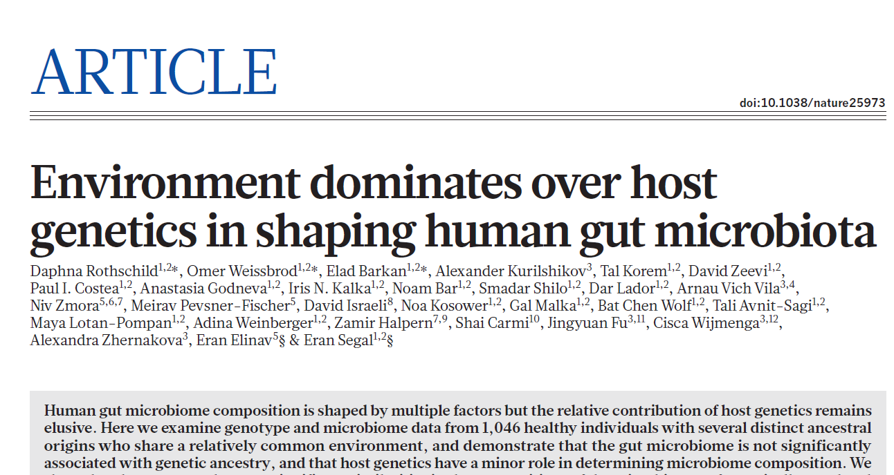
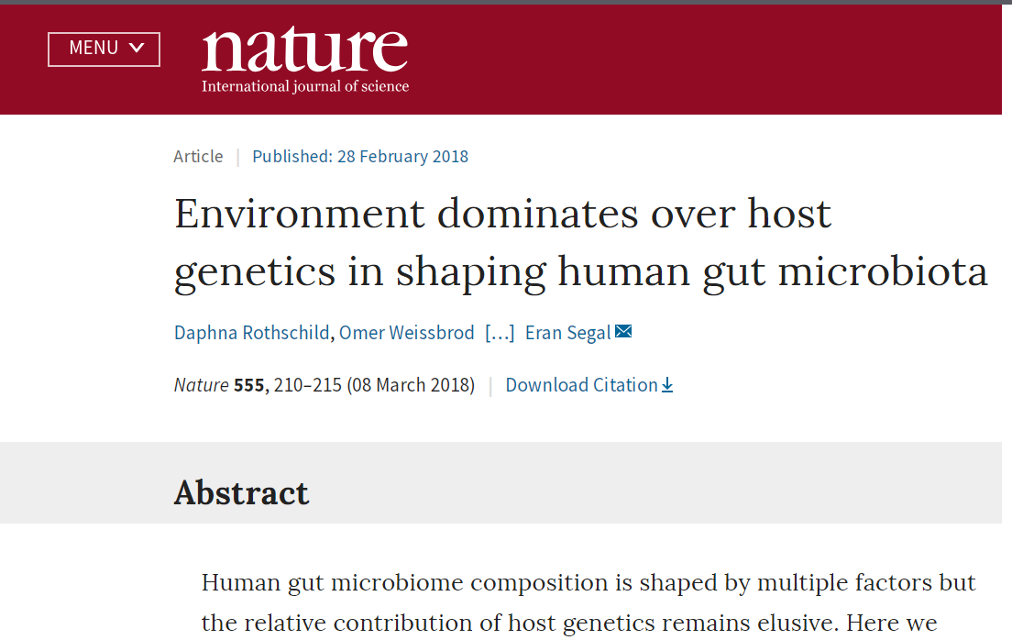





Health: It’s Not All About Your Genes
Metabolomics highlights normal and abnormal chemical reactions that are the root cause of health and disease
Metabolic impact—not just genetics—has a foundational role in determining health
Mice Clones
+
+
Unrestricted diet
Calorie restricted diet
=
=
Disease and early death
Long healthy life
Rothschild et al, Nature, 2018 Mar 8;555(7695):210-215. DOI:10.1038/nature25973

Slide 8
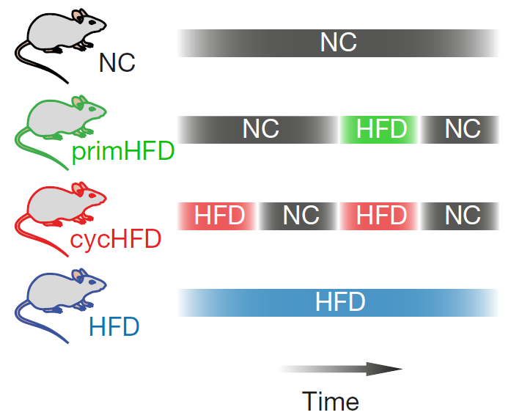
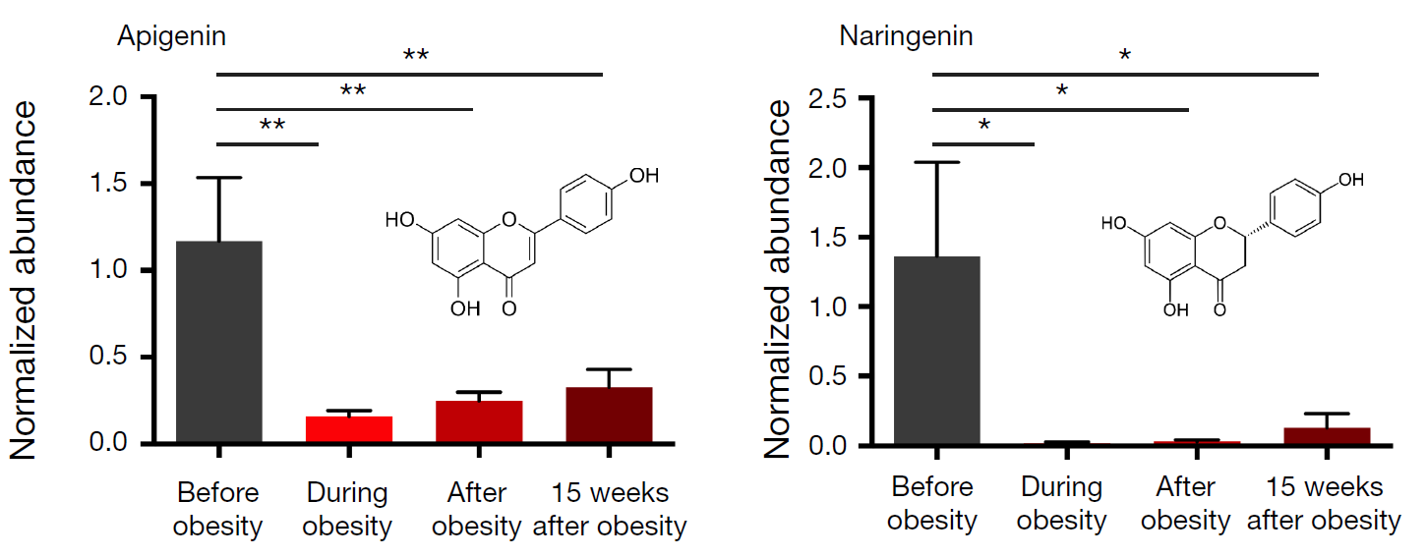
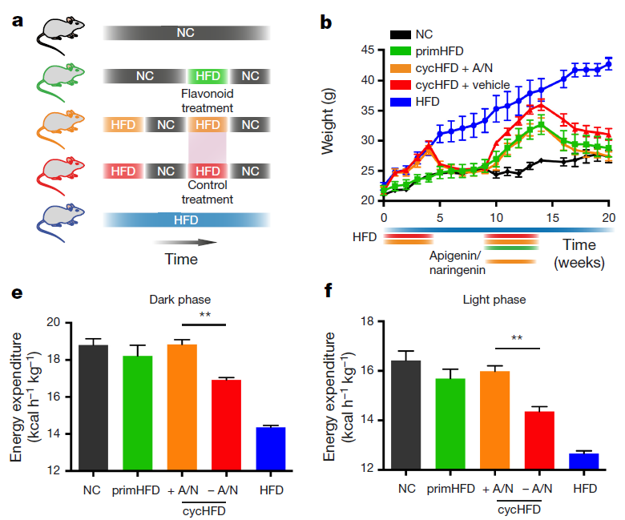
Untargeted and unbiassed profiling elucidates novel mechanisms
Dieting individuals fail to maintain weight loss.
Dieting individuals fall into a cycle of repeated weight loss and weight gain.
Investigators hypothesize that the preceding weight gain/weight loss cycle predisposed the mice to accelerated weight gain after receiving a HFD, and that the microbiome may play a role in this effect. To test, turned to microbiome and metabolite profiling.
Flavonoid metabolism is indicative of weight gain.
Obesity drives a dramatic shift in microbial profile, where some of those microbes were either lost or gained. Once the animal loses weight, only 45% of those changes were reversed back to the pre-obesity state, while the rest of the microbial changes persist weeks after obesity.
Among those that persist are the flavonoids (apigenin and naringenin) levels reduced during obesity and persist for 15 weeks after obesity (equivalent to 26 years of human life).
Novel flavonoid pathway elucidated in brown adipose tissue.
High fat diet there is a dramatic shift in bacterial composition to favor flavonoid degradation.
Flavonoids are involved in energy expenditure, reduced flavonoids = reduced energy expenditure.
Mechanism: expression of the major thermogenic factor in brown adipose tissue, uncoupling protein 1 (Ucp1) is directly linked to flavonoids in a concentration-dependent manner.
Thaiss C., et al. Nature (2016) 540.7634. doi:10.1038/nature20796

Slide 9
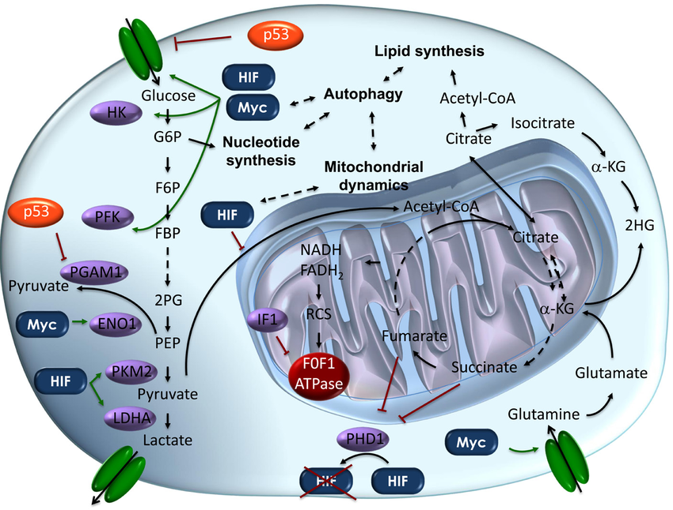
Metabolomics—Connecting Cancer Genetics to Phenotype
Each hallmark of cancer reveals interaction and engagement with diverse metabolic processes—from angiogenesis to immune evasion, metabolic pathways are of fundamental importance.
Genetic drivers of cancer-profiling as diagnostic tools have been in the mainstream.
Metabolomics
Reveals phenotypic characteristics underlying gene perturbation
Fills gaps not enabled by genetic profiling
Allows translatability of findings across model systems due to phylogenetic conservation of metabolic networks
Figure from: Corrado M, Scorrano L, Campello S. Changing perspective on oncometabolites: from metabolic signature of cancer to tumorigenic and immunosuppressive agents. Oncotarget. 2016;7(29)​ This open-access article is distributed under the terms of the Creative Commons Attribution License (CC BY 2.5).​

Slide 10
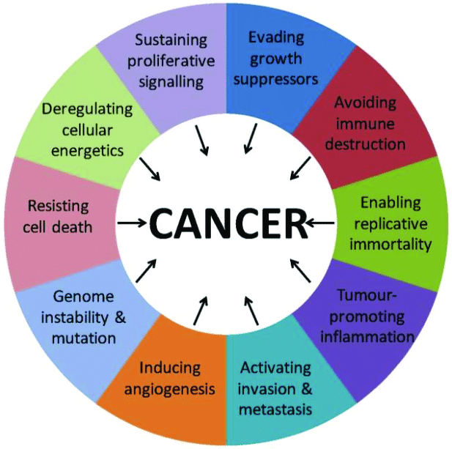
Metabolomics—Connecting Cancer Genetics to Phenotype
Each hallmark of cancer reveals interaction and engagement with diverse metabolic processes—from angiogenesis to immune evasion, metabolic pathways are of fundamental importance.
Genetic drivers of cancer-profiling as diagnostic tools have been in the mainstream.
Metabolomics
Reveals phenotypic characteristics underlying gene perturbation
Fills gaps not enabled by genetic profiling
Allows translatability of findings across model systems due to phylogenetic conservation of metabolic networks
Figure reproduced and adapted from: El-Tanani M, Dakir E-H, Raynor B, Morgan R. Mechanisms of Nuclear Export in Cancer and Resistance to Chemotherapy. Cancers. 2016; 8(3):35. https://doi.org/10.3390/cancers8030035 This open-access article is distributed under the terms of the Creative Commons Attribution License (CC BY 4.0).

Slide 11
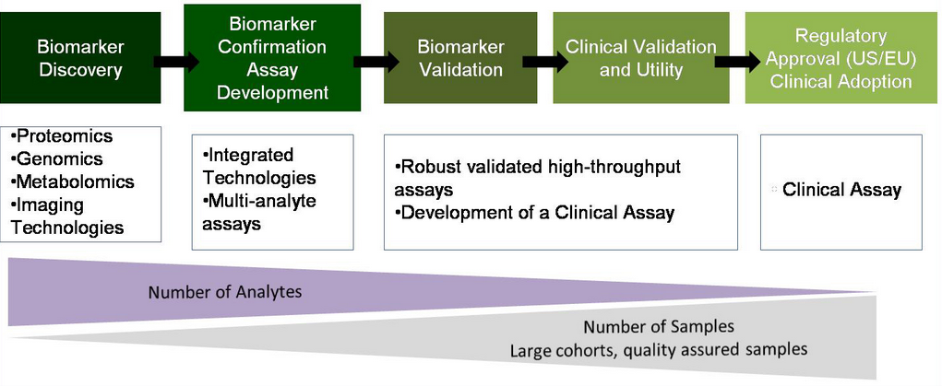
Metabolon: A Strategic Partner
From basic research through clinical
Biomarker Discovery Biomarker Validation
Basic Research
Discovery
Preclinical Development
Clinical Development
Phase 1
Phase 2
Phase 3
Molecular pathways leading to disease
Mechanism of action
Drug Target Selection
Mechanism of action
Dose selection
PK-PD
MoA, Dose selection, PK-PD, Safety
Dose selection, Efficacy, PK-PD, Safety
Patient selection, Stratification,
Efficacy
Customize
Global Discovery Panel
5,400+ metabolites
(relative quantification)
Targeted Panels and Assays
1 to 20 metabolites per assay
(absolute quantification)
Metabolon Portfolio
Standardize
Automate
Notes:
Metabolomics is applied from basic research with the discovery of molecular pathways leading to disease, through to translational and pre-clinical research- with biomarkers helping with the understanding of the mechanism of action, in PK-PD studies and dose selection. But ultimately biomarkers are also crucial during the clinical trial phases in which biomarkers can help with patient stratification and patient selection, Trial quality: (identifying outliers, or addressing compliance and site issues), as well as dose selection and the assessment of safety and efficacy, as well as studying Phenotypic exploratory endpoints, just to name a few.

Slide 12
How Investigators Incorporate Our Data Into Their Workflow
Discovery: highly powered population studies to identify signatures of disease
Functionally map disease causing genes
Biomarker assessment of target engagement and pharmacodynamics
Biomarkers of response for clinical trials
Novel therapeutic or diagnostic targets
Understand functional outputs of the microbiome that influence health

Slide 13
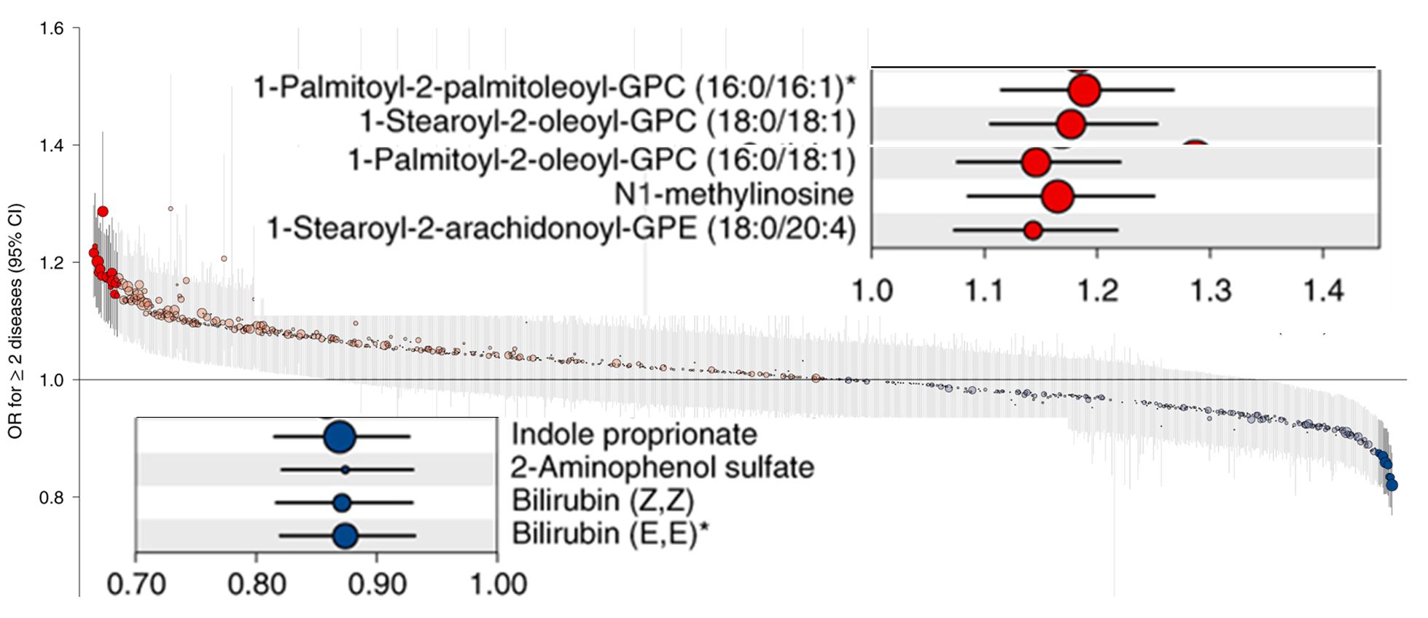
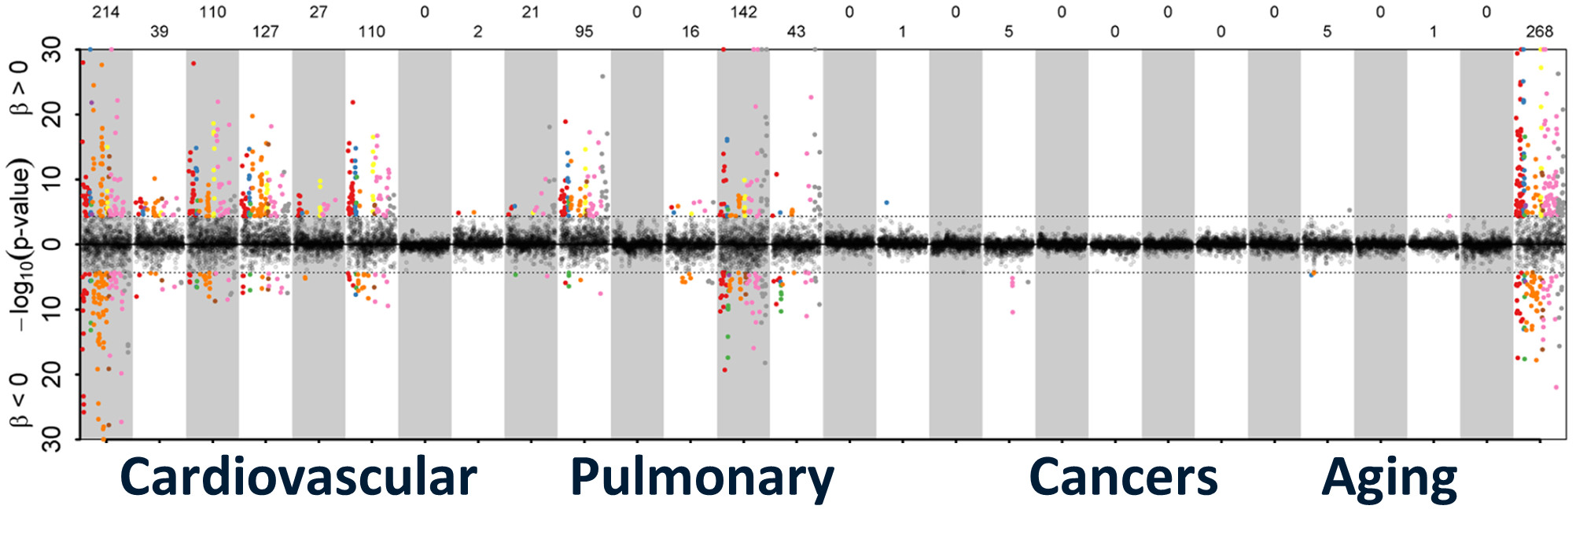
Discovery: Highly Powered Population Studies To Identify Signatures Of Disease
Actionable antecedents of multimorbidity identified
Mirrored Manhattan-like plot showing the p-values from Cox proportional hazard models
New clinical strategies are needed for complex disease with multimorbidity profiles.
There are current gaps in knowledge on common modifiable factors that underpin simultaneous multiple chronic conditions for more effective prevention and management of multimorbidity.
Metabolomics was used to identify pathways at baseline shared across multiple incident conditions to identify biochemical perturbations that predispose individuals to multimorbidity.
Two-thirds of associated metabolites are shared among diseases.
A total of 420 (65.6%) metabolites were associated with at least 2 different diseases or all-cause mortality (P < 0.001; while only 220 (34.6%) metabolites were associated with one disease only.
A high connectivity among cardiometabolic and respiratory diseases including coronary heart disease, heart failure, type 2 diabetes, cerebral stroke, peripheral artery disease, renal and liver diseases, chronic obstructive pulmonary disease, and lung cancer across different biochemical classes of metabolites was observed.
Novel biomarkers and pathways of multimorbidity were identified, accelerating therapeutics.
Large putatively protective role for gut microbial diversity from biochemical profiling.
Impaired glucose homeostasis, low-grade inflammation, lipoprotein metabolism, liver and kidney function were identified as common actionable antecedents of multimorbidity.
https://omicscience.org/apps/mwasdisease/
Pietzner M, et al. Nature Medicine. 2021: 471–479. DOI:10.1038/s41591-021-01266-0

Slide 14
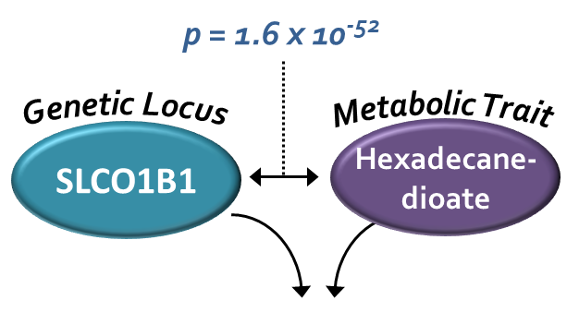
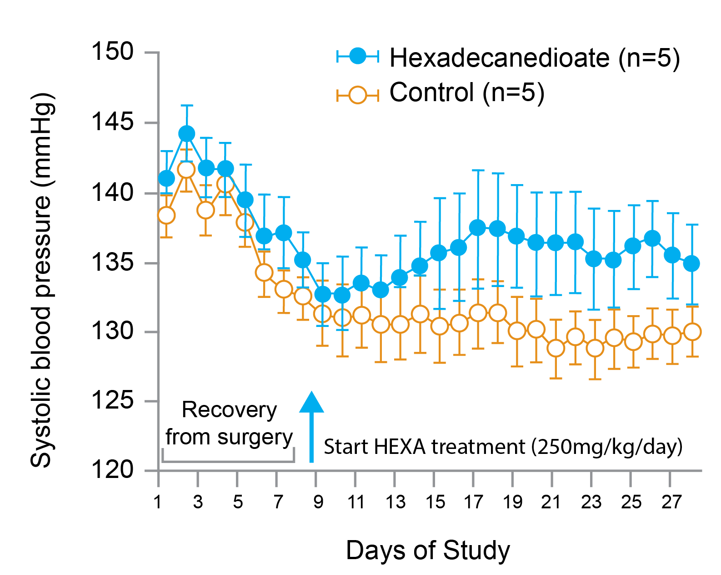
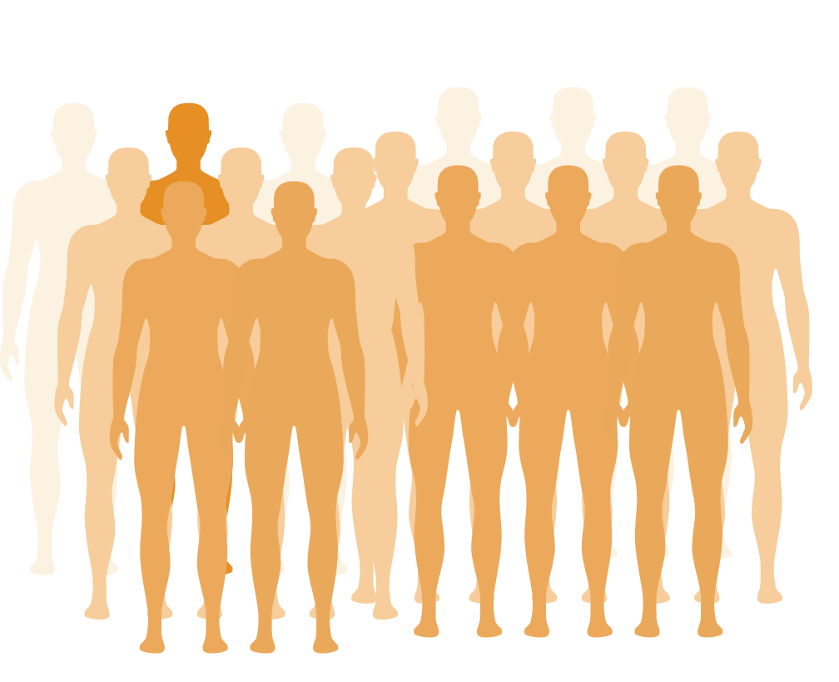
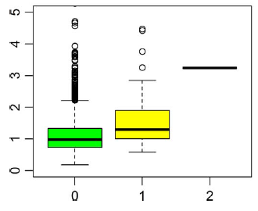
Functionally Map Disease Causing Genes
New therapeutic insights to treat hypertension
Metabolomic + cohorts and translational studies
Sequencing + metabolomics
SLCO1B1
Hexadecanedioate
Gene variant (SLCO1B1) + metabolite (HEXA) for high blood pressure
Altered blood pressure
Increased mortality
# LoF Alleles
New targets desperately needed
An estimated 1.13 billion people worldwide have hypertension.
Fewer than 1 in 5 people with hypertension are properly managed with current therapies.
Leads to premature death and new targets are needed for effective therapies.
Metabolomics identifies a metabolite causal for high blood pressure (BP) and functionally maps associated gene of unknown function
Can metabolomics help identify important genes faster?
Test case: high BP:
As of 2020, over 1.5 billion people are reported to have high BP; 2/3 have not achieved target therapeutic control with current therapeutics
Hexadecanedioate (HEXA) was highly associated with BP in three cohorts and shown to be causal.
New paradigm for finding targets and unlocking human health and disease:
Identification of a novel target; avenues into gene function and the understanding of disease etiology by integrating omic technologies into a deeply phenotyped populations
S.Y. Shin et al., Nat Genet (2014) 46:543-550 DOI:10.1038/ng.2982
E Link et al., N. Engl J Med (2008) 359:789-799 DOI:10.1056/NEJMoa0801936;
C. Menni et al., Hypertension (2015) 66:433-429 DOI:10.1161/HYPERTENSIONAHA.115.05544
B. Yu et al., Sci Adv (2016) 2:e1600800. DOI:10.1126/sciadv.1600800
Menni et al. (2017) PLoS ONE 12(4): e0175479. DOI:10.1371/journal.pone.0175479

Slide 15
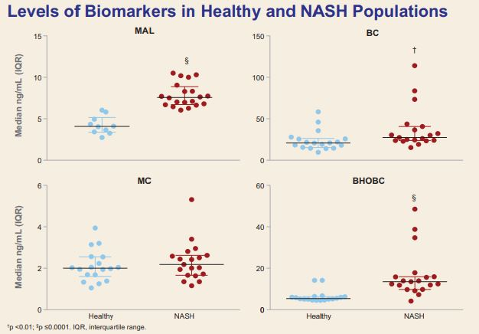
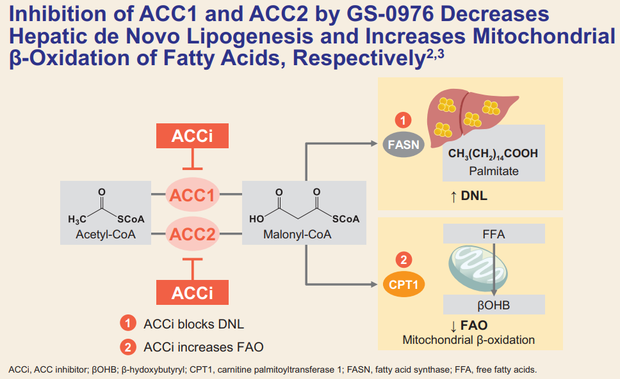
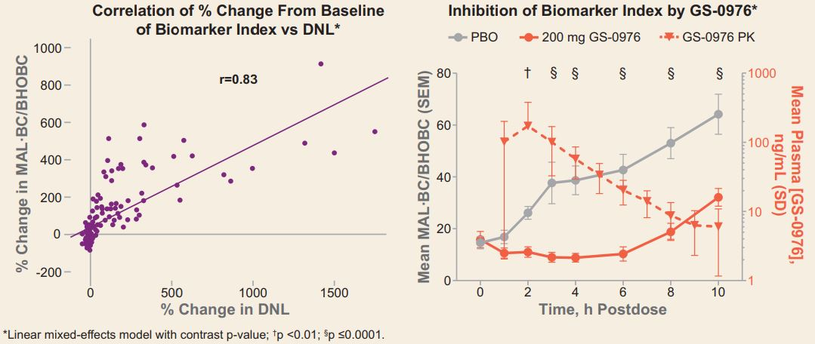
Biomarker assessment of target engagement and pharmacodynamics
Acetyl-CoA carboxylase inhibitor clinical evaluation
Simplified approach to assessing new non-alcoholic fatty liver disease (NASH) therapeutics
Typical approach to hepatic de novo lipogenesis (DNL) and FAO – use specialized stable isotope tracing studies – limit wider application
To evaluate a panel of plasma metabolites as potential pharmacodynamic (PD) markers of GS-0976
Metabolomics to improve diagnostic performance
Custom-targeted metabolite panel developed for accurate quantification
Malonate (MAL), butyryl carnitine (BC), and β-OH-butyrylcarnitine (BHOBC) were elevated in NASH patient's vs healthy subjects
In 10 fasted healthy subjects administered GS-0976 20 mg, there was a median 2.2-fold increase (range 1.3–3.1; p < 0.01) in BHOBC 4 h post-dose, which reversed to pre-dose levels at 10 h
Percent changes in MAL, BC, and BHOBC correlated well with percent change in DNL (p < 0.001)
New possible biomarker identified
BHOBC was a PD biomarker of GS-0976
MAL, BC, BHOBC, and a simple index accurately measured GS-0976 suppression of DNL
These metabolites show promise in evaluating GS-0976-related activity
Tarrant, Jacqueline M., et al. "Activity of Acetyl-CoA Carboxylase Inhibitor GS-0976. (2017)"
Notes:
This was a poster presented by Gilead Pharma]
Introduction
- Hepatic de novo lipogenesis (DNL) and fatty acid oxidation (FAO) are dysregulated in nonalcoholic steatohepatitis (NASH), and are implicated in disease pathogenesis1
- GS-0976 is an oral, liver-targeted inhibitor of acetyl-coenzyme A (CoA) carboxylase (ACC) in clinical development for the treatment of NASH
- Hepatic DNL and FAO are typically measured using stable isotope tracer studies by specialist laboratories, which limits wider application of this technique in large clinical studies
- A simplified approach to assess the impact of new NASH therapeutics on hepatic DNL is needed
Objectives:
- To evaluate a selected targeted panel of plasma metabolites as potential pharmacodynamic (PD) markers of GS-0976
- To determine whether a selected panel of plasma metabolites are mechanistic biomarkers of DNL in a fructose-stimulated challenge study
Method
- Study populations to explore values of fasting biomarkers:
-18 healthy subjects (4 female, 14 male; body mass index [BMI] 20–29 kg/m2 [NCT02891408])
-19 NASH patients (13 female, 6 male; BMI 26–42 kg/m2) diagnosed noninvasively by hepatic proton density fat fraction ≥10% by magnetic resonance imaging and liver stiffness ≥2.88 kPa by magnetic resonance elastography (NCT02781584)
- Study population for pharmacokinetic (PK)–PD study:
– 10 healthy subjects (4 female, 6 male; BMI 20–28 kg/m2) administered GS-0976 20 mg qd in fasted state for 28 d (NCT02876796)
– Blood was collected at multiple time points after overnight fast, with continued fasting until 4-h postdose, on Days 1 and 28: 0 (predose, ≤5 min prior to dosing), 1, 2, 3, 4, 6, 8, 10, 12, 18, and 24 h postdose
- Plasma levels of MAL, MC, BC, and BHOBC were quantified by liquid chromatography–tandem mass spectrometry (AB Sciex QTRAP 5500-Agilent 1290 LC, Metabolon, Inc., Morrisville, NC)
Results
- MAL, BC, and BHOBC were elevated in NASH patients vs healthy subjects
- In 10 fasted healthy subjects administered GS-0976 20 mg, there was a median 2.2-fold increase (range 1.3–3.1; p <0.01) in BHOBC 4h postdose, which reversed to predose levels at 10 h
- Percent changes in MAL, BC, and BHOBC correlated well with percent change in DNL
Conclusions
- Plasma levels of MAL, BC, and BHOBC were elevated in NASH patients compared with healthy subjects
- BHOBC was a PD biomarker of GS-0976 treatment in fasted, healthy subjects (in absence of DNL stimulation)
- Plasma MAL, BC, BHOBC, and a simple index (MAL∙BC/BHOBC):
– Were significantly correlated with fructose-stimulated hepatic DNL as measured by stable isotope incorporation in very low-density lipoprotein over time; and
– Accurately measured treatment suppression of DNL
- These metabolites show promise in evaluating GS-0976-related activity

Slide 16
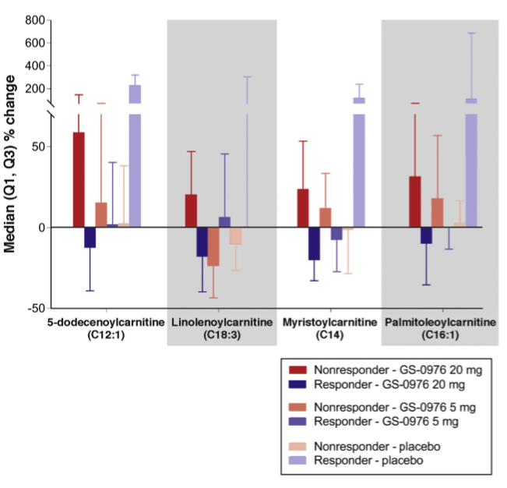
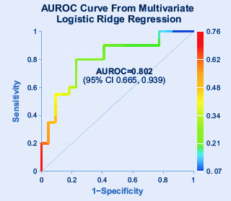
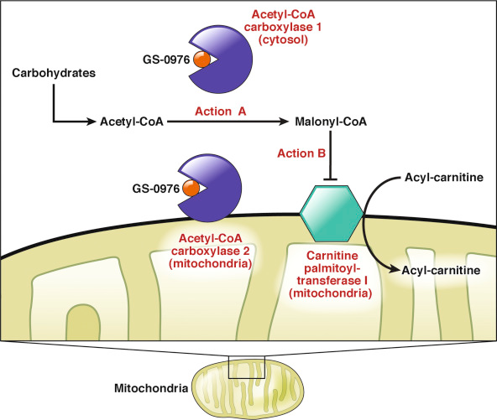
Biomarkers Of Response For Clinical Trials Novel NASH program
Panel of 4 ACs had good AUROC for diagnosing MRI-R at Week 12 (change from baseline)
Proposed mechanism of action by GS-0976
Biomarkers of response
Acylcarnitines (AC) changed with imaging, providing candidate markers for development
Developed a targeted, assay panel of 22 ACs
Relative changes from baseline in AC levels between magnetic resonance imaging-estimated proton density fat fraction (MRI-PDFF) responders and MRI-PDFF nonresponders were significantly different at week 12 in dosed group
New potential targets identified
A panel of metabolites are promising early biomarkers of imaging response
Mechanistically linked to ACCi and liver fat content
Provides confidence to advance program with an expanded toolbox of biomarkers
Markers of clinical response needed
NASH efficacy assessment is limited to imaging or biopsy with no reliable blood biomarker options
Sought plasma biomarkers of response in Phase 2 trial for NASH with novel molecule, acetyl-CoA carboxylase inhibitor (ACCi)
Loomba, Rohit, et al. Gastroenterology 155.5 (2018): 1463-1473.
Charlton, Michael, et al. Presented at EASL: The International Liver Congress™ 2019, April 10–14, 2019, Vienna, Austria
Notes:
The last study for today focusses once again on an ACC inhibition drug, but this time in the context of finding biomarkers that correlate to the response of patients to this specific treatment with the ACC inhibitor. This was part of a larger safety and efficacy study of the drug of interest.
This study was conducted with 126 patients with different stages of hepatic steatosis. For this phase II trial patients were randomly grouped and given GS-0976 20 mg, GS-0976 5 mg, or placebo daily for 12 weeks.
Hepatic steatosis, stiffness, serum markers of fibrosis, and plasma metabolomics were evaluated.
Primary aims were to confirm previous findings and evaluate the relation between dose and efficacy.
A relative decrease of at least 30% from baseline in MRI-PDFF (PDFF response) occurred in 48% of patients given GS-0976 20 mg, 23% given GS-0976 5 mg
On the metabolomics side – Although minimal differences were observed between treatment groups, multiple long- and medium chain acylcarnitine species were significantly suppressed in the GS-0976 20 mg group who achieved a PDFF
response vs those without a PDFF response
They concluded that the in this study that the treatment was safe and well tolerated, asymptomatic and dose-independent hypertriglyceridemia was observed in some patients mostly on the higher dosage and in most cases with previous history of hypertriglyceridemia.
Decreases of multiple plasma acylcarnitine species in treated patients with a PDFF response suggest that these metabolites could be useful surrogate markers of enhanced mitochondrial btea-oxidation during ACC inhibitor treatment.

Slide 17


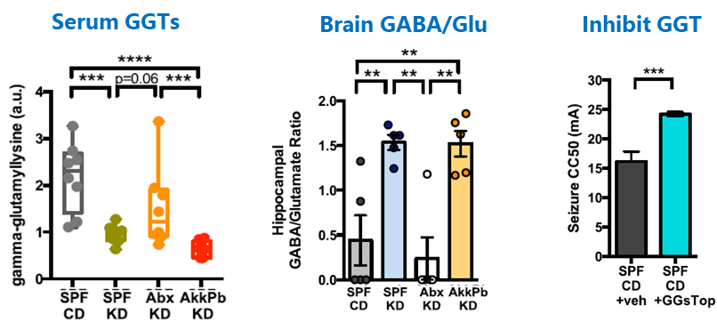
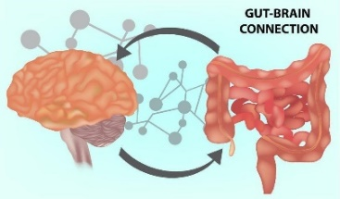
Novel Therapeutic Or Diagnostic Targets
Metabolites deliver actionable insights in microbiome research
Ketogenic diet
Metabolomics
Blood—↓ gamma glutamyl amino acids
Brain— ↑ GABA/glutamate
Seizure protection
Need for treatment strategies
The ketogenic diet (KD) is an effective treatment for refractory epilepsy; it was a mystery how it worked
Researchers at UCLA found that the KD works through the gut microbiome
How host bacteria produce this benefit was unclear
Metabolomics identifies a marker that illuminated efficacy
Diet reduces ketogenic gamma-glutamyl amino acids (GGTs) in seizure protected mice (serum)
Serum levels lead to shift in brain GABA/Glu ratio
Certain strains mimic diet effect through GGT activity as does inhibition of GGT activity with oral inhibitor
New target and biomarker identified
A molecular understanding of how the KD works was revealed
The findings open the potential for more targeted and consistently effective approaches
This work spawned a new company focused on metabolic targets of neurologic disorders.
Olson, Christine A., et al. ‘The gut microbiota mediates the anti-seizure effects of the ketogenic diet.’ Cell 173.7 (2018): 1728-1741.
Notes:
The last study for today focusses once again on an ACC inhibition drug, but this time in the context of finding biomarkers that correlate to the response of patients to this specific treatment with the ACC inhibitor. This was part of a larger safety and efficacy study of the drug of interest.
This study was conducted with 126 patients with different stages of hepatic steatosis. For this phase II trial patients were randomly grouped and given GS-0976 20 mg, GS-0976 5 mg, or placebo daily for 12 weeks.
Hepatic steatosis, stiffness, serum markers of fibrosis, and plasma metabolomics were evaluated.
Primary aims were to confirm previous findings and evaluate the relation between dose and efficacy.
A relative decrease of at least 30% from baseline in MRI-PDFF (PDFF response) occurred in 48% of patients given GS-0976 20 mg, 23% given GS-0976 5 mg
On the metabolomics side – Although minimal differences were observed between treatment groups, multiple long- and medium chain acylcarnitine species were significantly suppressed in the GS-0976 20 mg group who achieved a PDFF
response vs those without a PDFF response
They concluded that the in this study that the treatment was safe and well tolerated, asymptomatic and dose-independent hypertriglyceridemia was observed in some patients mostly on the higher dosage and in most cases with previous history of hypertriglyceridemia.
Decreases of multiple plasma acylcarnitine species in treated patients with a PDFF response suggest that these metabolites could be useful surrogate markers of enhanced mitochondrial btea-oxidation during ACC inhibitor treatment.

Slide 18
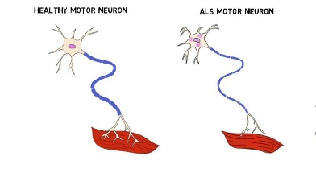
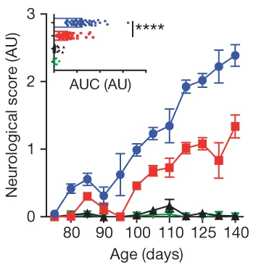
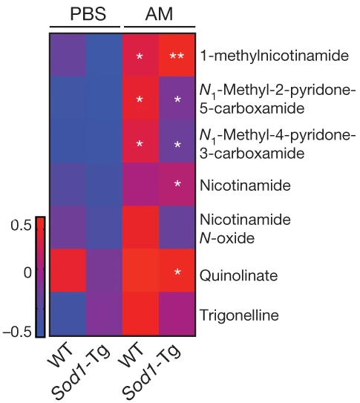

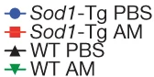
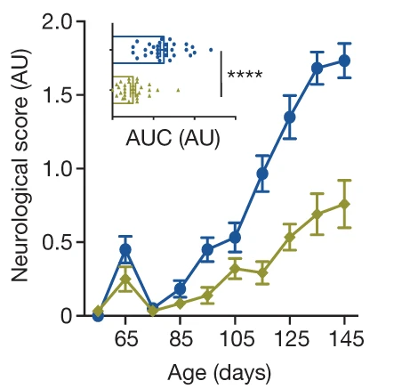
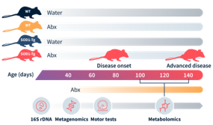
Understand Functional Outputs Of The Microbiome That Influence Health
The role of bacterially generated nicotinamide (NAM) to treat amyotrophic lateral sclerosis (ALS)
NAM levels are ↓ in ALS patients
Improved neurological score with A. muciniphila (AM)
AM treatment ↑ serum & cerebral spinal fluid (CSF) NAM level in ALS mice
Improved neurological score of ALS mice treated with NAM
Depleting the microbiome of Sod1-Tg ALS mouse model exacerbates motor symptoms
Treatment strategies needed
ALS is a neurodegenerative disorder that is characterized by the premature death of motor neurons; few treatment options
Factors, such as gut metabolites that can permeate the blood brain barrier (BBB), have been postulated to modify the course of the disease
Metabolomics identifies NAM biosynthesis in AM treated ALS mice
Metagenomic shotgun sequencing revealed that the gut microbial composition of Sod1-Tg mice diverged from WT even before the appearance of motor dysfunction, particularly A. muciniphila (AM).
AM colonization ameliorated motor degeneration
AM colonization ⬆ nicotinamide (NAM) levels that improved motor performance in ALS mice
Potential treatment target identified
Motor dysfunction associated with ALS may be rescued with NAM
Translational potential as NAM levels are ⬇ in ALS patients
Blacher E, et al. Nature. 2019;572(7770):474–80. DOI:10.1038/s41586-019-1443-5

Slide 19
Summary
We offer unparalleled coverage of all biochemical pathways and continue to actively expand our capacity, library, and insights.
We have deep expertise across the entire arc of sample analysis to provide support for the broadest range of questions.
Our technology has been instrumental in functionally mapping over 800 genetic variants relevant across all disease processes.
Biochemical profiling is uniquely suited to elucidate small molecule messengers from microbial metabolism that influence every organ system and biological process.
Every disease requires a metabolic change positioning our technology as a cornerstone molecular phenotyping tool.
Notes:
All while maintaining the highest precision

